Slide 1
#SeeYouOnTheRoad Competition
Education made for young people by
young people

Slide 2
Are you artistic? Great with graphics? Good at designing social media content?
We want to hear from you!
We are looking for creative ways to share our road safety messages across Wiltshire & Swindon.
Enter our competition for young people in Key Stage 2, 3 & 4 to design a poster, social media image or animation that we can use to spread awareness of the risks of pedestrian distraction.
The top winning designs will be shared on our social media channels and on posters around Wiltshire & Swindon, as well as receiving a prize for both you and your school.

Slide 3
Why do we need this campaign?
Sadly, there were over 100 people were injured as pedestrians on the roads in our area last year.
Your age are most at risk...
BUT – with your help, we can do something about that!
Most children leave primary school knowing the Green Cross Code, but one of the main reasons that so many collisions happen in this age group, is that people are distracted and don’t look properly when walking, riding or scooting.

Slide 4
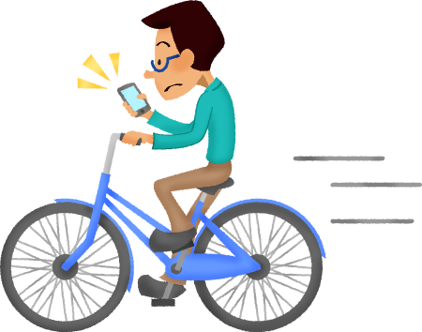
The second highest cause of collisions is the driver failing to look properly and not seeing the pedestrian – make sure you have been seen before you cross!
The number one cause of serious collisions involving pedestrians is the pedestrian failing to look properly when crossing the road

Slide 5
Can you guess the 3rd & 4th most common causes?
The third reason, although the pedestrian confirms they saw the vehicle, is that they failed to judge its path or speed correctly
The forth reason… confirmed by the injured pedestrian, is that they were in a hurry!

Slide 6
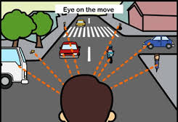
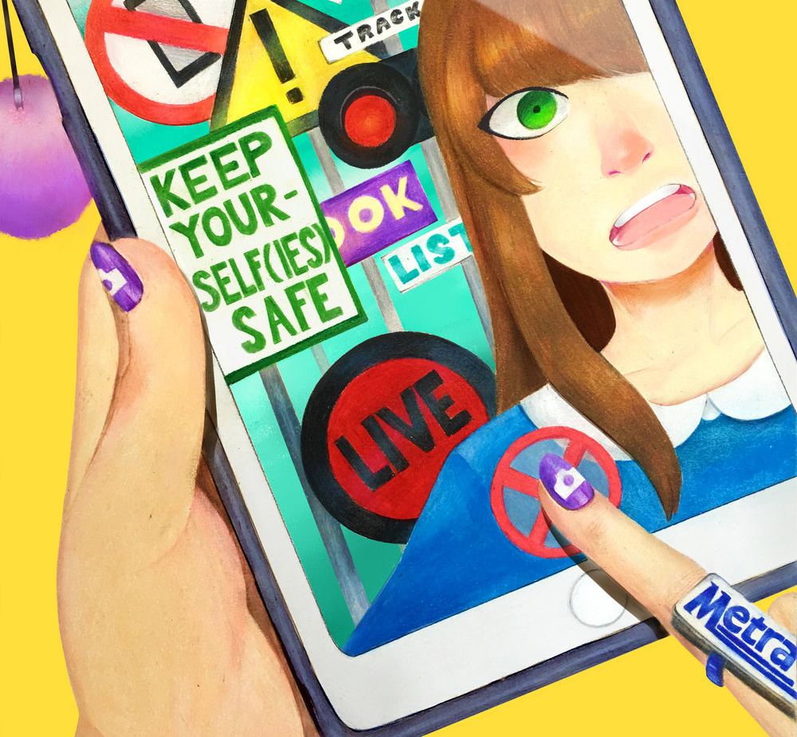
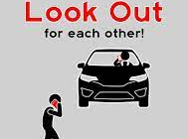
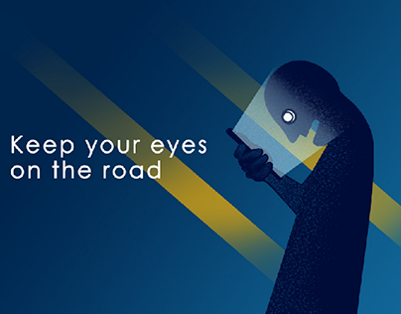
See you on the road
With these statistics in mind, our campaign is called ‘see you on the road’ as we want everyone to be alert to other road users and to look out for each other on the road. It’s a simple message, but a simple thing that could dramatically reduce the serious injuries on our roads.
We’re looking for social media images that you have designed. This can be hand drawn or using digital graphics or animations, or even a short film – but the content must be your own.
We need the image to portray the message ‘See you on the road’ with the key theme being looking out for other road users, whether they are walking, running, riding, scooting or driving…

Slide 7
Here are our top tips that you might think about incorporating into your campaign design:
Look out for vehicles on the road, especially when crossing. Making eye contact with a driver is a good way of ensuring they have seen you before you step into the road.
When walking with friends, make sure you are all paying attention to the roads you cross and you aren’t distracting each other - mates look after mates.
If you’re on your phone, make sure that doesn’t take your attention away from the road. Eyes up, phone down.
Listening is key – if you’ve got headphones on, mute your playlist to cross the road, or keep one ear on traffic at all times.
If you are riding a bike, don’t use headphones at all, it just isn’t safe.
Remember the Green Cross Code when you cross: Stop, Look & Listen, Wait, Look & Listen again before crossing.
Find a safe place to cross where you can clearly see the road and where drivers can see you.
Be bright, be seen – dress to be seen, especially in the dark or in poor weather conditions.

Slide 8
Entry details
Complete the form Contact detail & permission (so we can let you know if you have won a prize) and send your entry to roadsafety@dwfire.org.uk by 23rd December 2024.
A panel of judges will choose a shortlist of
images that will be shared on social media throughout December.
Three winners will be announced in January:
The winner of each category will each receive a £20 Amazon gift voucher.
Books to the value of £20 will also be awarded to the winner's school.
Follow us on our social media pages and look out for the top entries that we will share throughout January. Good luck!
@dwfire
The full terms and conditions can be found here: https://www.dwfire.org.uk/education/road-safety/wiltshire-swindon-road-safety-competition/

