Slide 1
Squirrels
Year 3/4 Curriculum Meeting 2023

Slide 2
Welcome to BADGERS CLASS 2022.
Class Teachers
Mrs Hillier
Teaching assistants for Maths and English – Mrs Leatham and Mrs Sweeney
Daily timings
Squirrel’s lessons will start at 8.30 a.m. The school day finishes at 3 p.m. Children continue to enter through the front entrance of school. We will dismiss children from the gate leading to the field entrance. (In case of bad weather we will dismiss through the front gate).
Communication books
We will continue to use communication books. If you have any concerns or worries please write in the book and we will try to answer any questions you have. We will also ask children to stick any first aid slips in them to ensure that they are not misplaced before home time! Please ensure that these books are kept in your child’s book bags. All home learning app codes are stuck inside the front cover for the children to access at home.

Slide 3
Squirrel Class Charter
We have the right to an education and will respect this by having a positive and resilient attitude to our learning.
We have the right to have a go and make mistakes – this is how we learn.
We have the right to be respected and we will respect others by listening, being kind, telling the truth and standing up for our friends.
We have the right to be safe and we will respect this by looking after our environment and school property.
We have the right to be proud of our work and we will respect this by persevering with our learning and ensuring we present our work to the best of our abilities.
We have the right to follow our dreams and we will respect this by not giving up and asking for help when we need it.

Slide 4
English - How is it taught?
Small group work / differentiated or scaffolded tasks
Practical / drama / freeze frame / hot seating.
Meaningful contexts - writing linked to high quality text.
Develop English language – grammar and spelling activities.
Personal / Peer review of writing – children work together to talk / evaluate / review/ edit their writing.

Slide 5
Reading – how is it taught?
We use whole class guided reading.
This enables everyone in the class, no matter their word reading ability, to learn new vocabularly, discuss high quality texts and collaborate with their peers.
We use chapters or extracts from books.
We teach vocabulary and prosody as well as comprehension.
We also have reading for pleasure on a Friday afternoon where the children can bring in books, magazines, comics etc from home. They can also choose to read their reading or library book from school.

Slide 6
Reading for Pleasure class reader

Slide 7
The Rights of a Squirrel Reader.
We have the right to:
Pick and read ANY age appropriate book.
Have our own opinion on a book
Read with anyone
Talk about books
Like or NOT like a book
Get emotional about a book
Read anything, not just books, wherever you want
Re-read a book
Take ideas from books and use them!

Slide 8
Spellings
We use the SCODE spelling system.
This follows on well from Little Wandle by looking at sounds and the different ways they are coded.
Each child has their own book which is completed after the teaching input.
Spellings are set on Spellingframe weekly.
Children are split into different groups so that their spellings are appropriate for them. Most children will have the spellings following our SCODE rules.
I have shown the children how to use spelling frame and explained that they need to do at least one test each week.
There will be a spelling test on Friday mornings where the children will be given sentences to write containing their spelling words. I try to use words in the sentences that they should be able to spell and I expect them to use the correct grammar in these sentences. For example, capital letters, full stops, inverted commas (year 4).
If the children get all their spellings and grammar correct they get 2 spelling credits. It they get all their spellings correct but miss some grammar points they receive 1 spelling credit. 10 spelling credits means that they get a trip to our spelling shop!

Slide 9
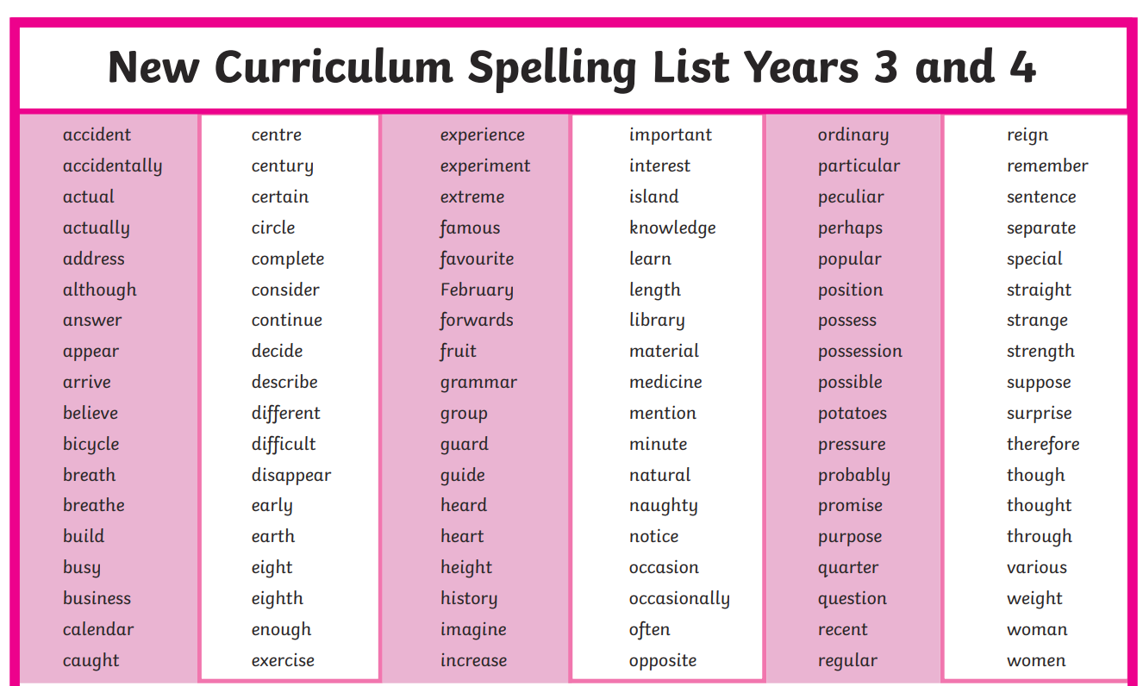

Slide 10
Handwriting
Handwriting will be taught in school.
If your child brings a handwriting sheet home please could you encourage them to complete it.

Slide 11
Maths - How is it taught?
Small group work / differentiated tasks
Practical (use of concrete objects if needed)
Meaningful contexts – everyday maths
Develop maths language – through questioning and stem sentences. Working wall vocab.
Reasoning/ Problem solving.
Mastery tasks - readily available every lesson to extend learning.

Slide 12
Times tables
At the end of Year 4 the government have a times tables assessment that all year 4s will have to take part in.
All tables up to 12x12 will be in this assessment.
We start teaching children in Year 3 using a daily booklet.

Slide 13
Home Learning
Home learning will be set on Fridays and should be completed by Thursday of the
following week. If children have difficulty completing online home learning at home – they have the opportunity use the ipads at any break or lunchtime.
Spellings (Spelling Frame)
Maths (Mathletics)
Reading Please listen to your child read as much as possible – this shows that you value reading and encourages your child to read. Reading also helps a child with their spellings and their English written work as we encourage them to “magpie” ideas from books. Please can you sign their reading diaries when you hear them read.
It is also important that children are still read to. Listening to an adult read engages them in stories and helps them learn vocabulary that they might not come across in their own reading books.
Other – occasionally children might be given a poem to learn or another project to do over time.
(All login codes are stuck on the inside of the front cover of their communication books)
All tasks support the learning in school so that most children should be able to complete them independently. Please ask if you are not sure about something.

Slide 14
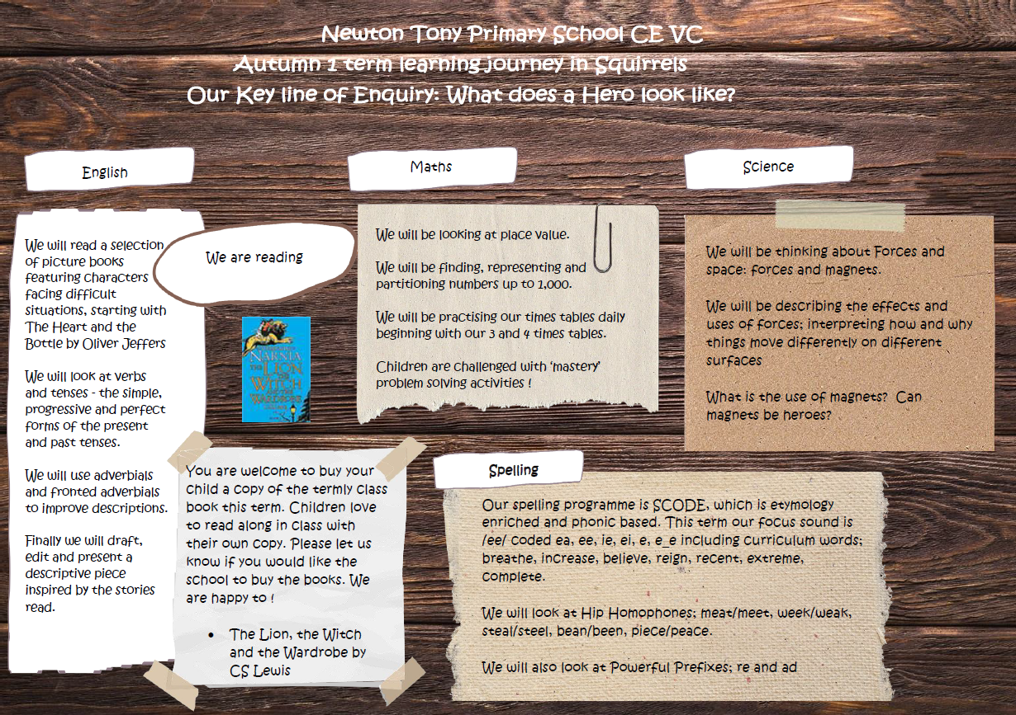

Slide 15
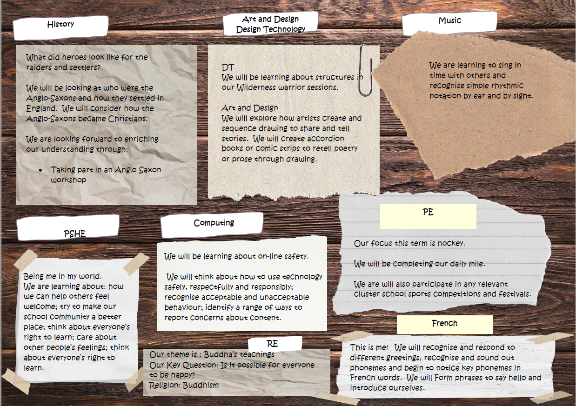

Slide 16
Things to Remember
Pupils should only bring in essential items (coats, water bottles, pencil cases and packed lunch if they do not have school dinners). Please do not bring in backpacks because these do not fit inside our lockers.
We start our learning at 8:30am and end of day is at 3pm.
Pupils should bring in a water bottle everyday, or they are welcome to leave it at school where it can be refilled.
PE Kits to be worn to school on PE days – this is Tuesdays and Fridays. In the Spring Term we will be having swimming lessons on Tuesdays so children will still come to school in PE kit and will bring their swimming equipment with them.

Slide 17
Please remember that I expect Squirrels Class children to make mistakes and get things wrong – we all do! In Squirrels we try to learn from our mistakes.
If you have any concerns about your child or the work they are doing please speak to me as soon as possible. You can email me on jhillier@newtontony.wilts.sch.uk or speak to me after school.

