Slide 1
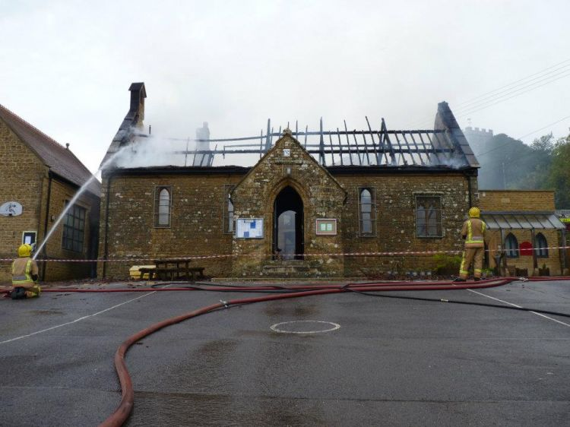
Annual Reminder of essential Fire Safety information in Schools
To try and prevent fires starting and spreading
To make sure everyone knows how to raise the alarm
To make sure everyone knows what to do upon hearing the alarm
Powerstock CE VA Primary School, Nr Bridport 24/10/11

Slide 2
As a School We Must:
Have a fire risk assessment carried out by a competent person;
Implement all actions from the fire risk assessment and review the assessment annually;
Have appropriate fire fighting equipment, adequate means of escape and a defined evacuation procedure;
Develop a Personal Emergency Evacuation Plan (PEEP) for anyone with a temporary or permanent disability that may prevent that person from being able to reach a place of safety;
Practice our fire evacuation procedures.
Notes:
When was your fire risk assessment carried out? Have this available for staff to see at the training.
Tell staff where are your extinguishers positioned and show them on a plan where the escape routes and assembly points are.
Do you have any PEEPs in place currently – if so show staff one. A PEEP should be drawn up for anyone who cannot leave the premises unassisted in an emergency for example this could be a pupil or member of staff with a broken leg (temporary disability) or in a wheelchair (permanent disability).
We carry out a fire drill 3 times per year – i.e. every other term.

Slide 3
Fire Prevention
The main causes of fires in schools are:
Electrical failure (mains and portable appliances);
Arson;
Use of chemicals and workshop machinery;
Poor housekeeping.

Slide 4
To help prevent electrical fires....
Switch off equipment when not in use;
Visually check equipment, sockets and switches before use;
Do not use extension leads and adaptor blocks that are linked together or overloaded;
Check operating instructions for reel type extension leads – should they be fully unwound before use?
Do not store items on top of or close to heaters;
Keep water and drinks away from electrical equipment.

Slide 5
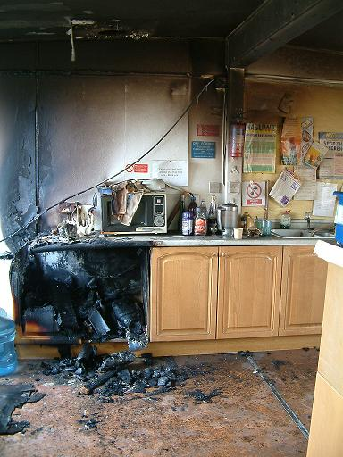
This fire was caused by a faulty electric kettle
Maybe like the one you use?

Slide 6
To help prevent opportunities for arson...
Keep all external areas clear of accumulated combustible materials;
Keep refuse bins at least 8m away from any building and secure them so they can’t be easily moved up against a building;
Report any external lighting that is not working.

Slide 7
To prevent chemical and workshop fires...
Don’t order and store large quantities of flammable liquids;
Don’t handle or mix science chemicals unless you have been trained to do so;
Don’t store oil-soaked rags or materials;
Make sure you know the isolation points for gas and electricity in the area you work.

Slide 8
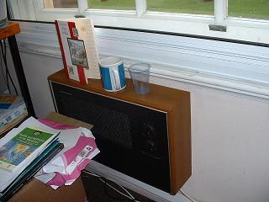
To help prevent general accidental fires
Do not store things on or near heaters or other surfaces that get hot;
Remove waste regularly so there isn’t a ready supply of flammable material to burn;
Keep all areas clean and tidy especially where dust or grease can build up.
No smoking on site.

Slide 9
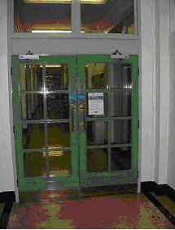
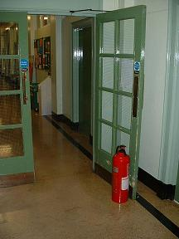
To prevent fire and smoke from spreading...
Fire doors stop fire and smoke spreading and protect escape routes.
Keep fire doors closed unless they are held open by automatic closing devices!
Report any defective doors and tackle persistent offenders!

Slide 10
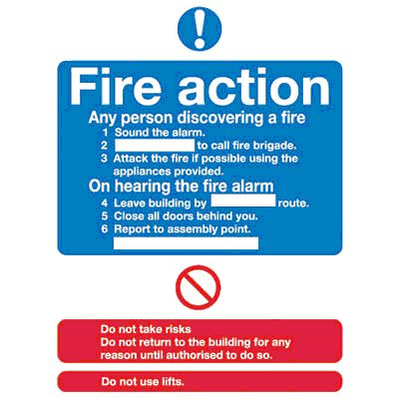
Fire Action Notices
Fire action notices which detail the evacuation procedure should be displayed adjacent to fire call points.
Make sure that the notices in your area are fully and legibly completed and up-to-date.

Slide 11
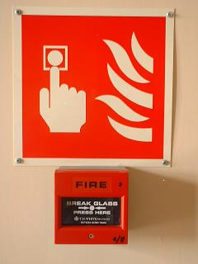
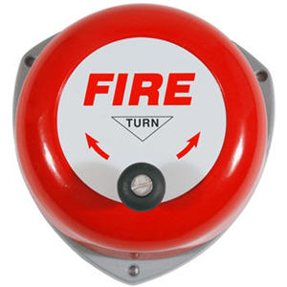
If you discover a fire:
Raise the alarm - do you know where your nearest call point is?
The school’s procedure for calling 999 is - Miss Priestley or Mrs Talbot-king will phone 999. (Mrs Hillier in Miss Priestley’s or Mrs Talbot-King’s absence)
Organise the calm evacuation of the area.If the fire is small and you feel confident to do so, use the correct type of fire extinguisher to try and put out the fire.
DO NOT PUT YOURSELF OR OTHERS IN DANGER!
Notes:
With this slide you need to be explicit about what your specific procedures are

Slide 12
If you hear the alarm....
Do not assume it is a drill or a false alarm;
Organise the calm evacuation of the area you are responsible for;
Close doors and windows as you go;
Go directly to your assembly point;
Do not re-enter the building until told to do so.
Practice Fire Drills...
Are conducted 3 times per academic year;
The time of the drill may be varied to capture different scenarios;
Report any problems encountered.

Slide 13
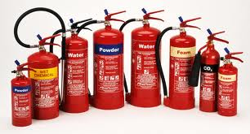
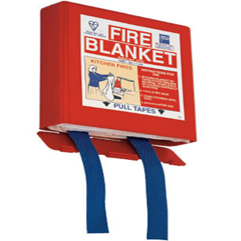
Fire Fighting Equipment
Suitable and sufficient fire fighting equipment is readily accessible and is available throughout the school.
All such equipment is checked annually by a competent person to make sure that it is in efficient working order.

Slide 14
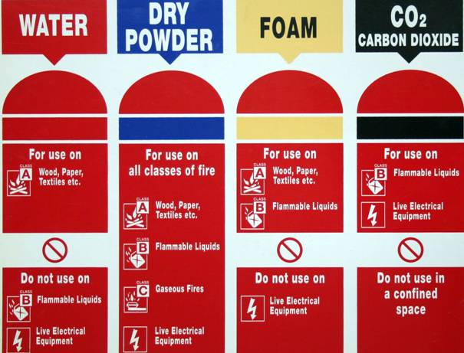
Types of Fire Extinguishers
Note when to use each of them - and just as importantly, WHEN NOT TO!

Slide 15
Fire Training Requirements:
All staff should be told about fire and emergency procedures on their first day (including supply staff, parent helpers, non-teaching);
All visitors and contractors, who may be left unaccompanied, must be briefed on the sound of the alarm and what to do if they hear the alarm when they first arrive on site;
All staff should receive this general awareness training on an annual basis;
Staff working in high fire risk areas and key personnel involved in the evacuation procedure should receive practical fire extinguisher training (every 3 years).

Slide 16
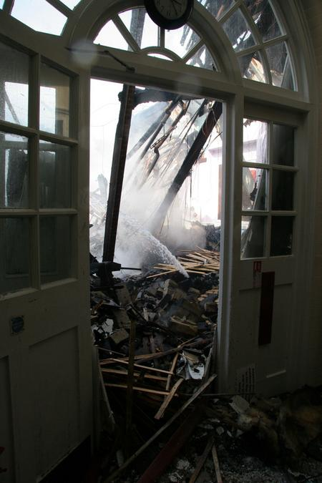
Remember - think about fire prevention...
The effect of a serious fire at our school would be devastating.
It is everyone’s personal responsibility to be vigilant for the potential of accidental or malicious fires.
That collective action will help protect the safety of all staff, pupils and visitors and the firefighters who we would rely upon to rescue us or our buildings.
Duke of York's Royal Military School, Dover 17/04/10

Slide 17
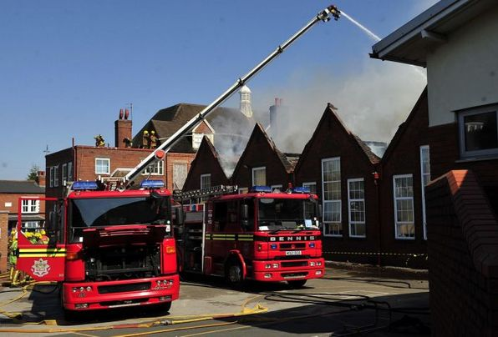
School Specific Fire Procedures
Miss Priestley and Mrs Hillier are Fire Marshalls
We meet on the playground by the assembly point sign
Harborne Primary School, Birmingham 27/04/11
Notes:
At this point you need to distribute your school emergency plan and go through the details.

Slide 18
Annual Reminder of essential Fire Safety information in Schools
You should be able to answer YES to all of these questions as they apply to you.
If you can't, ask a question now or talk to a senior member of staff.
Is the alarm audible in all occupied parts of the building?
Do you know of an alternative escape route out should your normal exit be blocked by fire or smoke?
Are these routes always clear of obstructions and locked doors?
Could you contact the Fire & Rescue Service if you needed to?
Do you know the out-of-hours fire procedures?
Do you feel safe and confident about the risk of fire in your school?

